Slide 1
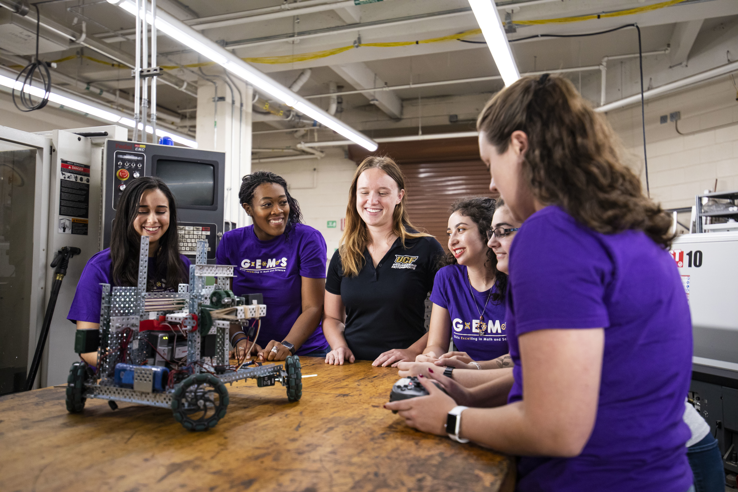
Women in Computer Science Partnership Melissa A. Dagley Executive Director, Center for Initiatives in STEM

Slide 2
Increasing Access and Graduation for Women
National Center for Women in Information Technology (NCWIT) and Google
NCWIT Seed Funding
Center for Inclusive Computing
Notes:
A core team that has been working together on increasing the number of women in CS/IT since 2014
Geared toward making curricular changes
Recitation sessions and use of TAs in COP 3223
Redesign of the FE (Removing COT 3100)
Limiting FE attempts
Adding MAC 2311 PR to COT 3100
2nd Phase – Seed Funding
Scholarships to K-12 camps for women (Cyber, CP and CS)
Department welcome message from ACM-W
Work with ACM-W to offer mentoring
Begin work to evaluate and redesign intro sequence
CIC

Slide 3
Center for Inclusive Computing
Curriculum
New Course - Introduction to Programming
Redesign gateway sequence
CS+X minor and majors
Women’s Coordinator
Women’s mentoring
Climate survey
Implicit Bias & inclusivity training
Notes:
New course
Provides a true introduction to coding for those without experience as well as introducing students to careers in CS/IT
Offers examples/assignments relevant to many disciplines
Included as part of the GEP
Redesign of Gateway Sequence
COP 3223 will be updated for experienced coders
Implement synchronized syllabus with common learning outcomes, some common assignments and training for faculty (adjunct or new)
Lead to changes for CS1
Design minors that encourage students to explore CS along with technical courses in their own majors
Eventually partner on CS+X majors
Coordinator in addition to working on project
Formally expand our successful GEMS and WISE mentoring programs to all CS/IT entering women
Complete the climate survey and coordinate training (part of project)

Slide 4
Center for Inclusive Computing
increase women graduating in CS/IT by 10%
Opportunity for additional funding by year end
Notes:
Ultimate goal is to increase the percentage of women graduating in computing by 10%
Original request was $2M, may have the opportunity to request additional funds by year end

Slide 5
Discussion

