Slide 1
MICROWAVE RADIOMETER (MWR) EVALUATION OF MULTI-BEAM SATELLITE ANTENNA BORESIGHT POINTING USING LAND-WATER CROSSINGS, FOR THE AQUARIUS/SAC-D MISSION
by Bradley Clymer
March 25, 2015
UCF CFRSL

Slide 2
Thesis Objective
Develop an algorithm to perform a quantitative evaluation of the geolocation accuracy of Microwave Radiometer (MWR) multi-beam footprints on the earth’s surface
Deliver statistical data to the CONAE for corrective action in future data processing
Process at least one year of MWR data and perform a statistical assessment of all individual beam footprints geolocation errors for (8 beams $×$ 3 frequency/polarization combinations)

Slide 3
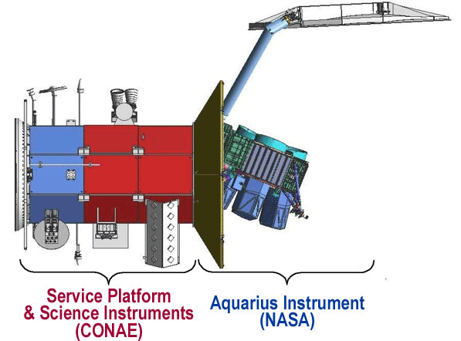
Aquarius/SAC-D Overview
NASA Aquarius instrument
Microwave radiometer/scatterometer
Operates at L-band (1.4 GHz)
3 beam IFOV’s (~ 150 km diameter) perpendicular to line of flight
380 km swath width
CONAE MWR Instrument
Provides geophysical retrievals that are collocated with AQ 3-beam footprints
K- (H-pol) and Ka-band (V&H-pol)
8 beams forward (Ka-band), 8 beams aft (K-band)

Slide 4
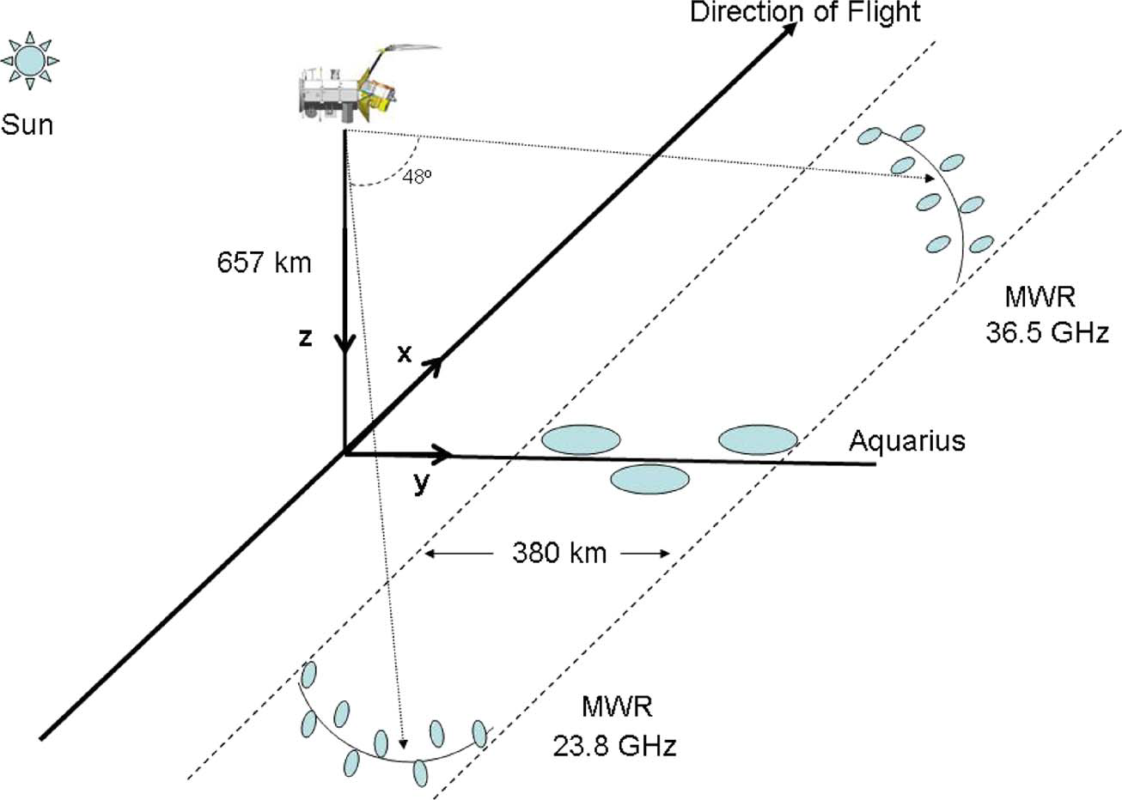
Instrument Geometry - Aquarius
AQ/SAC-D
Sun-synchronous polar orbiting satellite
AQ radiometer/scatterometer utilizes an offset parabolic reflector antenna in a pushbroom configuration
AQ beam geometry
3 Beams cross-track (azimuth 90º)
IFOV size:
79x94 km – 96x156 km
380 km swath

Slide 5
Instrument Geometry - MWR
MWR forward-looking beams
8 beams (Ka-band, V- & H-pol)
Fixed beams on conical arcs
Earth Incidence: 52º and 58º
IFOV size range: 25 x 50 – 30 x 60 km
MWR aft-looking beams
8 beams (K-band, H-pol)
Earth Incidence: 52º and 58º conical arcs
IFOV identical to forward beams

Slide 6
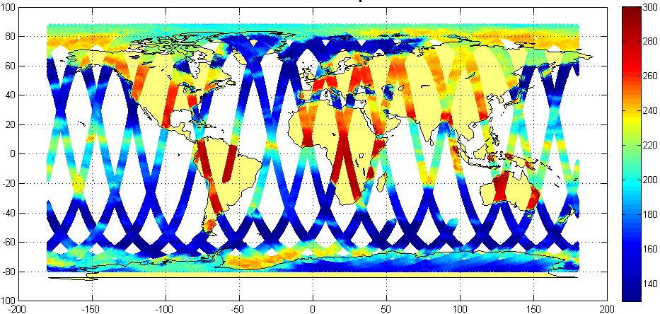
MWR $T_{B}$ Measurements – One Day
High contrast brightness temperature from ocean to land: maximum slope occurs at coastline and indicates ‘sensor observed’ boundary
Oribital cycle: 7 days – exact repeat
Width shown represents swath of all eight beams

Slide 7
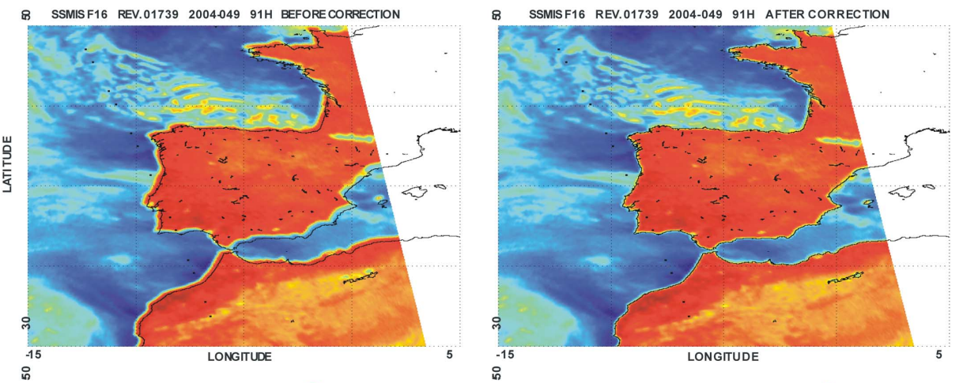
Past Work – 2004 SSM/I Radiometer Imager
High resolution Tb images compared to coastal maps to determine mispointing
Adjustment of satellite attitude: roll, pitch & yaw to determine “best pointing”
Before
Correction
After
Correction

Slide 8
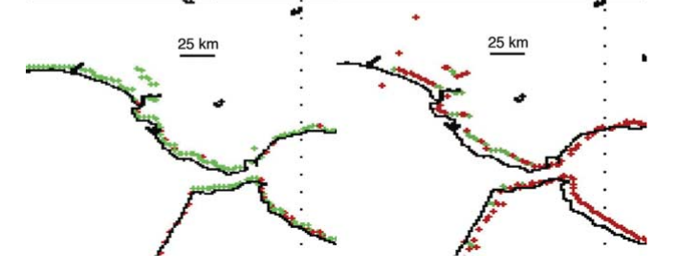
Past Work – 2006 WindSat Imaging Radiometer
Used Tb gradients to estimate land/water boundaries
Adjusted satellite roll and pitch to register image with coastline maps
Before
Correction
After
Correction

Slide 9
Past Work: Catherine May EE MS Thesis 2012, Engineering Evaluation Of Multi-beam Satellite Antenna Boresight Pointing Using Land/Water Crossings
Developed algorithm to determine MWR radiometer footprint geolocation at land/water boundaries relative to high resolution coastline maps
Used individual beam crossings with CONAE calculated IFOV centers
Processed ~ 3 months of MWR data
Manually picked supersites to show efficacy of slope technique
Produced sample datasets to calculate statistical geolocation errors for various antenna beams
Notes:
Assumption was 50% beam fill was max slope, mostly done by hand, did just enough to show proof-of-concept

Slide 10
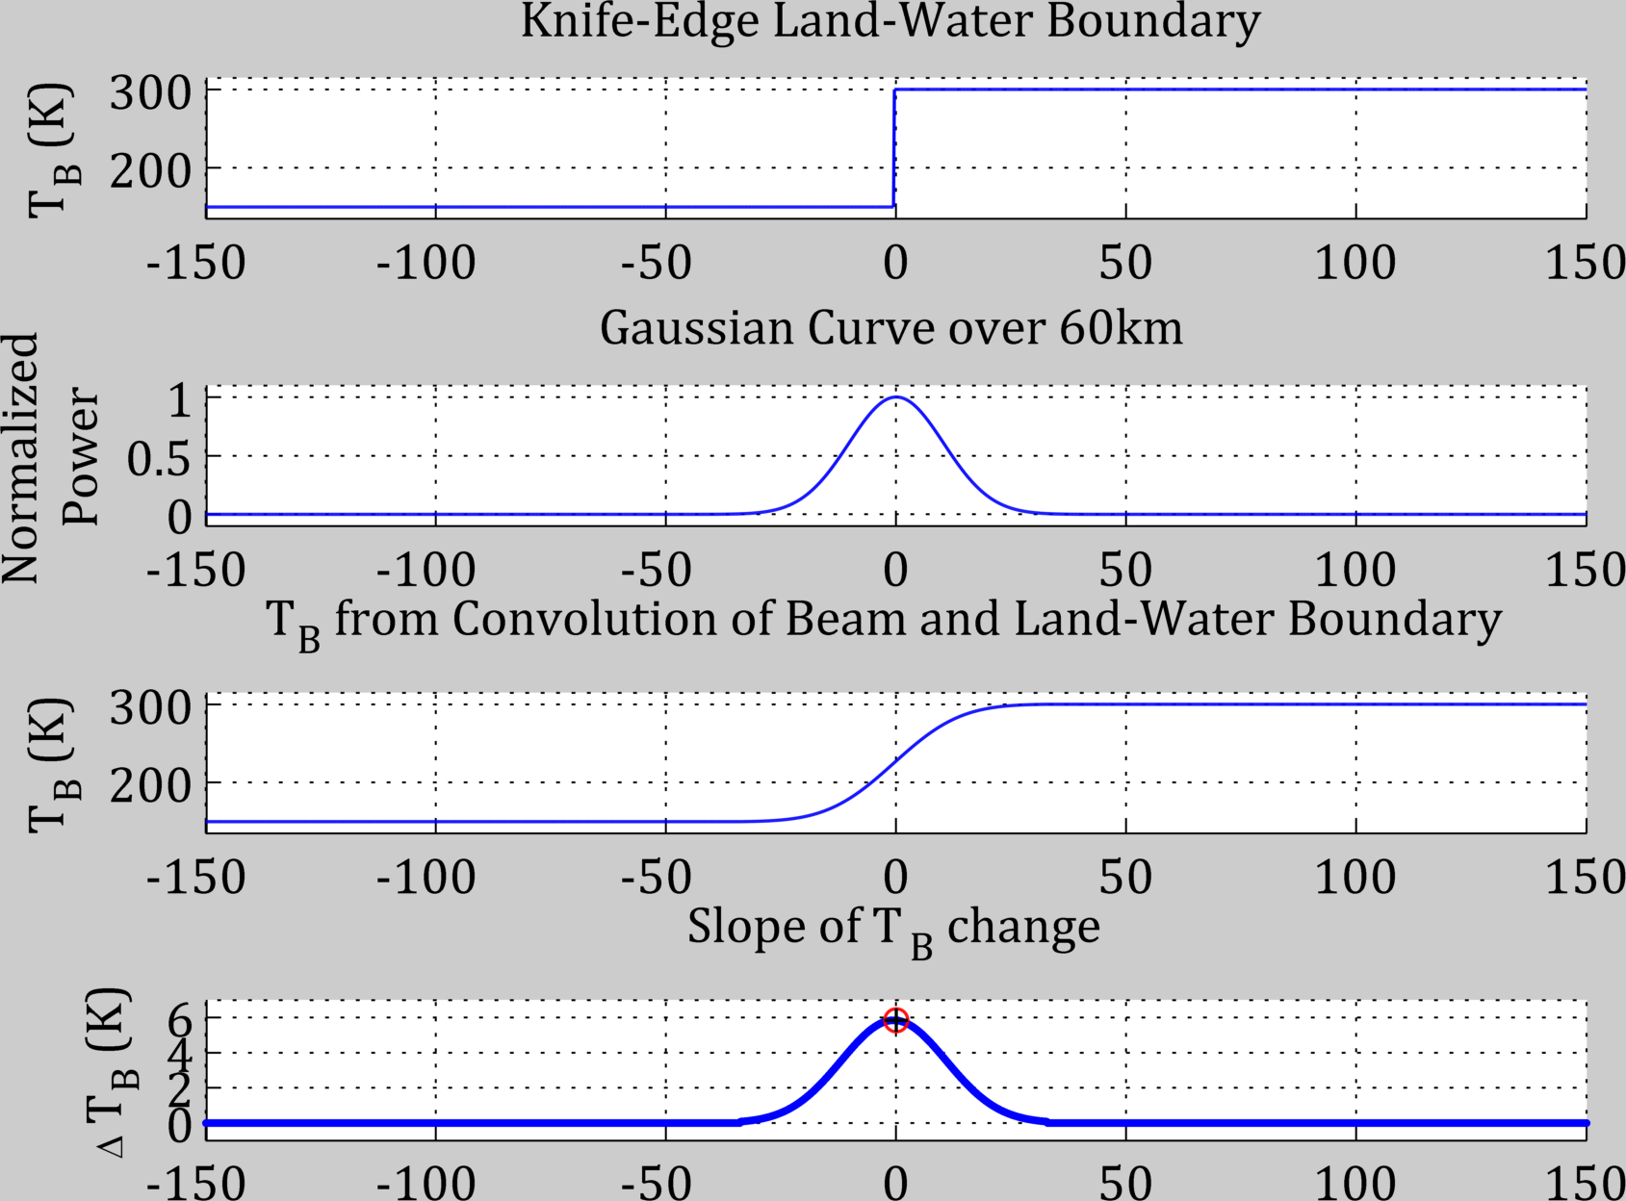
Past Work: Catherine May EE MS Thesis 2012,
Developed theoretical radiometer model
An Ideal radiomentric land/water boundary,
ocean
Land
When colvolved with an ideal 1D Gaussian beam pattern,
Produces a Sigmoid curve of apparent brightness temperatures,
The derivative of which is a Gaussian curve
[km]
Notes:
Assumption was 50% beam fill was max slope, mostly done by hand, did just enough to show proof-of-concept

Slide 11
Current Work
Implemented 2D MWR antenna pattern convolution of actual Tb coastline images to validate the 1D assumptions of 50% beam-fill = max Tb slope (C. May Thesis 2012)
Showed that 50% beam-fill was insensitive to orientation of elliptical IFOV axes relative to coastline crossing
Implemented improved geolocation error calculation (closest point to coastline)
Automated “SuperSite selection” to allow for large datasets to be generated (MatLab/Google Earth Link)
Performed one-year data processing (full seasonal cycle) and collected statistics of collocation error (km) for all 24 beams for asc and desc orbit passes

Slide 12
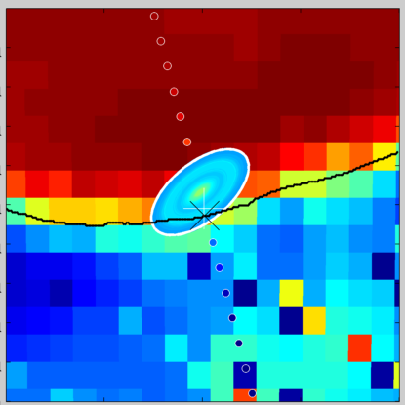
2D Theoretical MWR convolution vs. Measured Tb series
Theory
MWR measured

Slide 13
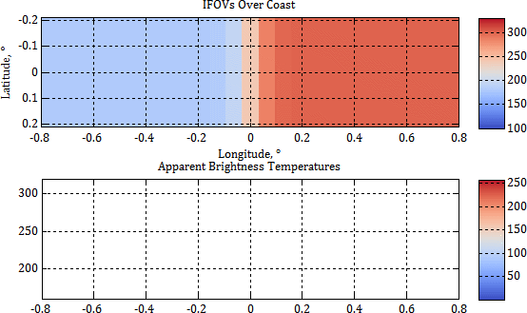
Brightness Temperatures Over a Coast
Water on left, land on right
Beam efficiency picks up incremental increase in radiated power
Gaussian ellipse approximation to more complex beam pattern
Steepest slope occurs at 50% beam-fill
50% fill point

Slide 14
What is a supersite?
Madagascar Coast example
Real-world land/water coastlines that have good characteristics
Long straight coastlines > IFOV dimensions
locus of IFOV center locations with ±45°crossing angles of coast
Dry land without major inland water
No significant man-made objects (roads, buildings, etc.)

Slide 15
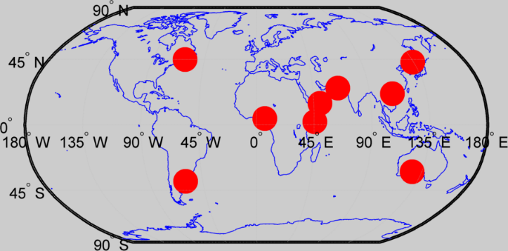
Super Site Locations for Geolocation Analysis
Below are examples of SuperSites selected for a single beam and polarization – 37V – ascending
On average, 7-20 sites for each of 8 beams
Notes:
Will be discussing where satellite crossings go over

Slide 16
Algorithm for Calculating Instrument-Observed Coast
Check Data Lat/Long for SuperSite Proximity
Difference Sequential $T_{B}s$
Fit Parabola to Neighborhood of Maximum Difference
Calculate Distance to Nearest Coastal Point
Interpolate Lat/Long of Vertex
Calculate Parabola Vertex
Aggregate Results by Site, Beam, and Polarization

Slide 17
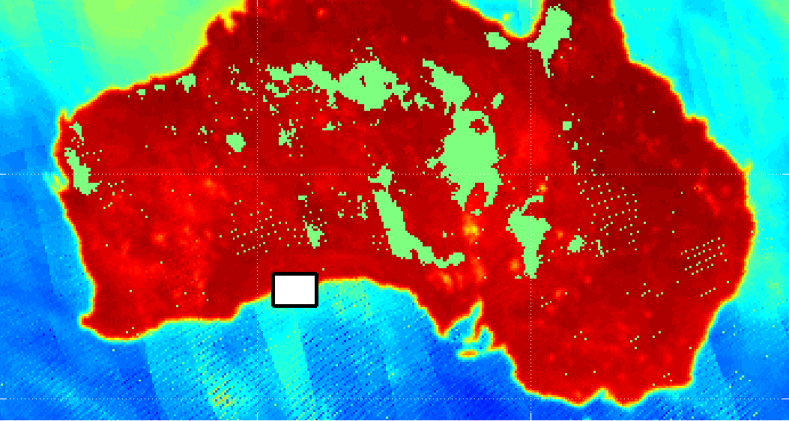
Select data from SuperSite region
Pre-select bounding box region
Typically ten to twelve geolocated $T_{B}s$

Slide 18
Fit least-squares parabola to neighborhood of maximum
Differences of successive points define slopes (yellow and green)
Parabola Maximum fits slopes
Vertex of Parabola defines crossing point
Note that nearly ideal case shows vertex closely aligned to an IFOV center
Fit Parabola
Derivatives

Slide 19
Difference $T_{B}s,$ assign slope location between points
Note that differences lie between $T_{B}s$
Typically 4-6 samples used for fitting

Slide 20
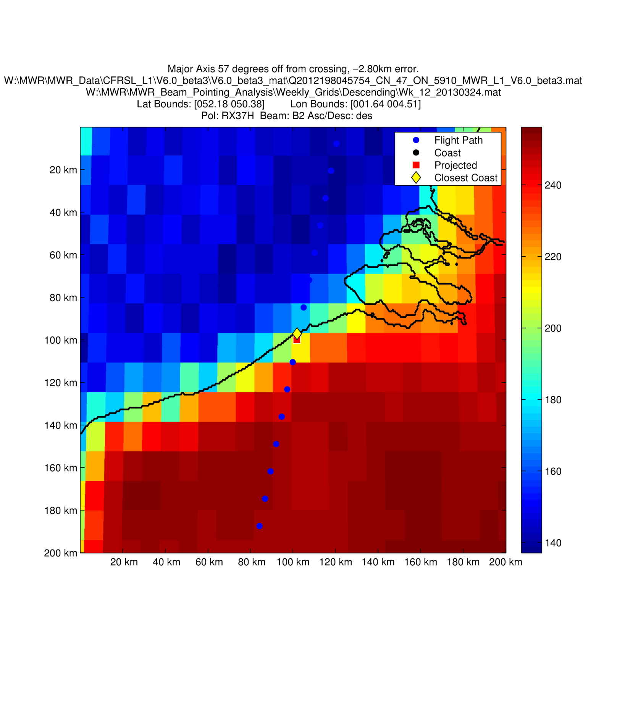
Interpolate vertex to a lat/long between data, find nearest coast
Geolocation
error
Notes:
This slide has about a million parts, DANGEROUS TO MOVE ANYTHING

Slide 21
Supersite Selection Algorithm
Classify each orbit by ascending node
Aggregate orbits into matrices
Take column-wise mean of each matrix
Difference each of 103 time series to find slope
Evaluate sites above desired threshold heuristically
Align matrices by ascending node

Slide 22
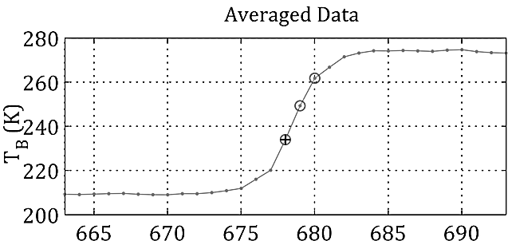
SuperSite Finding Algorithm: Step 5
Classify each orbit by ascending node
Aggregate orbits into matrices
Take column-wise mean of each matrix
Difference each of 103 time series to find slope
Evaluate sites above desired threshold heuristically
Align matrices by ascending node
Threshold
Samples

Slide 23
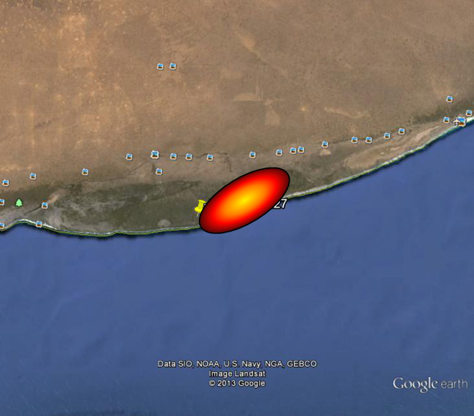
Supersite Selection Advances
Bulk Processing with minimal oversight
Evaluate visual fitness in Google Earth
Automated kml interface allows rapid selection and simple (yes/[]) input
Average of 16 supersites per beam and polarization

Slide 24
MWR Geolocation Results

Slide 25
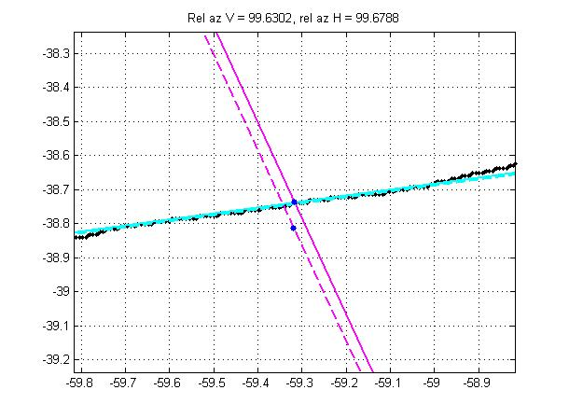
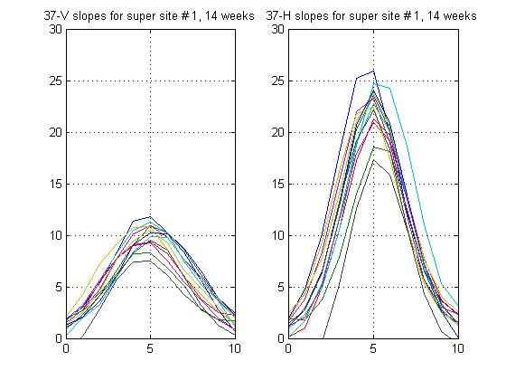
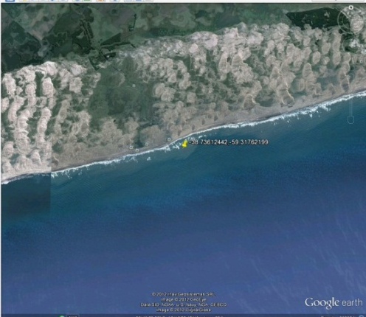
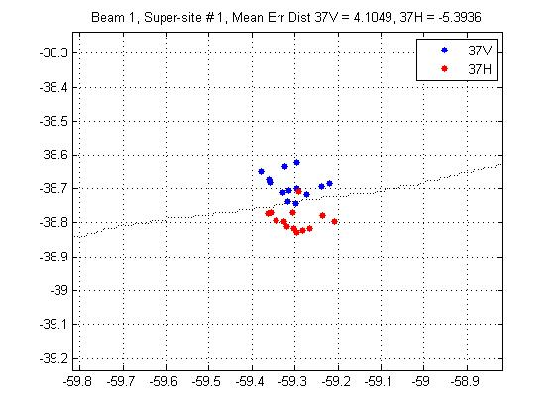
B1 Ascending Supersite No. 1, 14 AQ cycles
IFOV
trajectory
V- & H-pol
Tb slopes vs. distance
V-pol & H-pol
CONAE V- & H-
Boresight pointing
Google Earth View
Typical
MWR
IFOV

Slide 26
Error Analysis Results by Beam, 1-8
23H
37V
37H
Notes:
Chart of mean and STD vs. beam #, with error bars
Average location error Show plots of consistency between V & H, spatial collocation plot, consistent difference, V&H Disparity Table with 24 beams, mean error, columns are beam, rows are pols, mean error/std, one decimal place Histogram for consistency

Slide 27
37V & H Comparison by Beam, 1-8
37V
37H
Difference: 37H – 37V

Slide 28
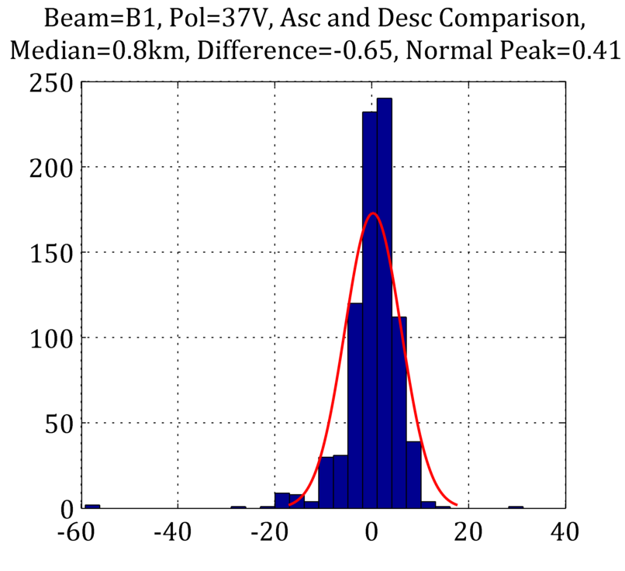
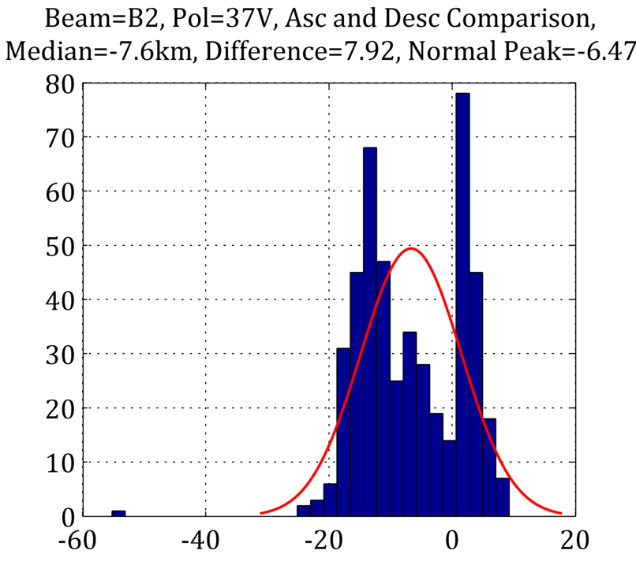
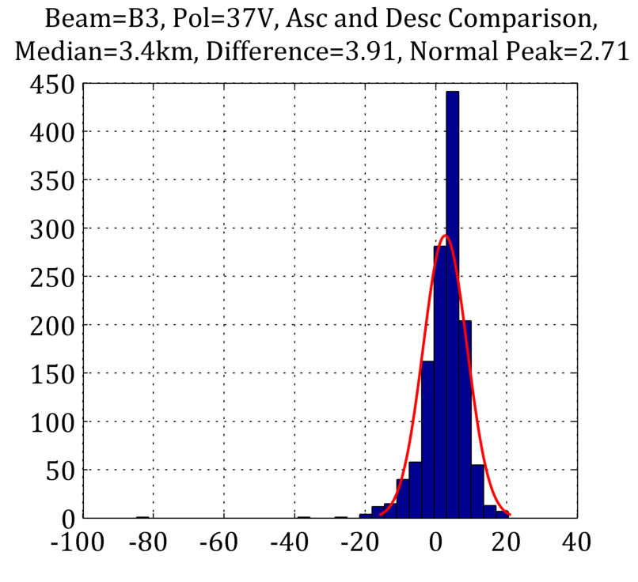
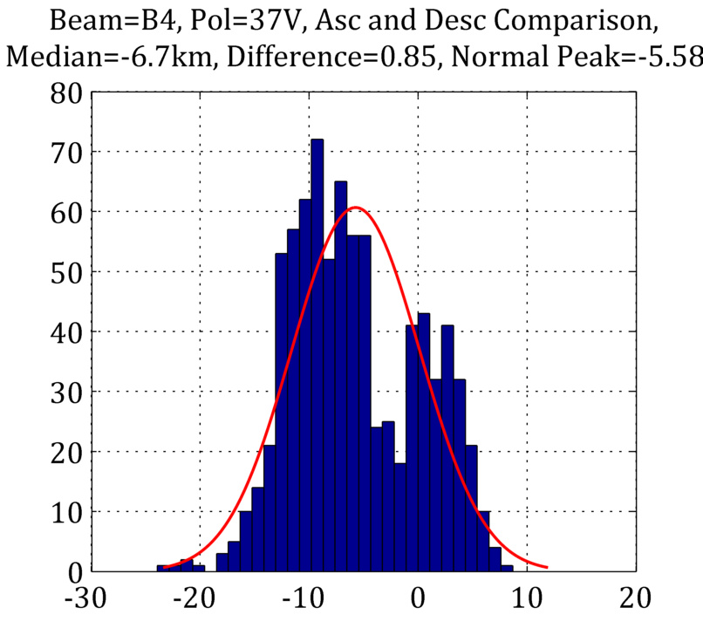
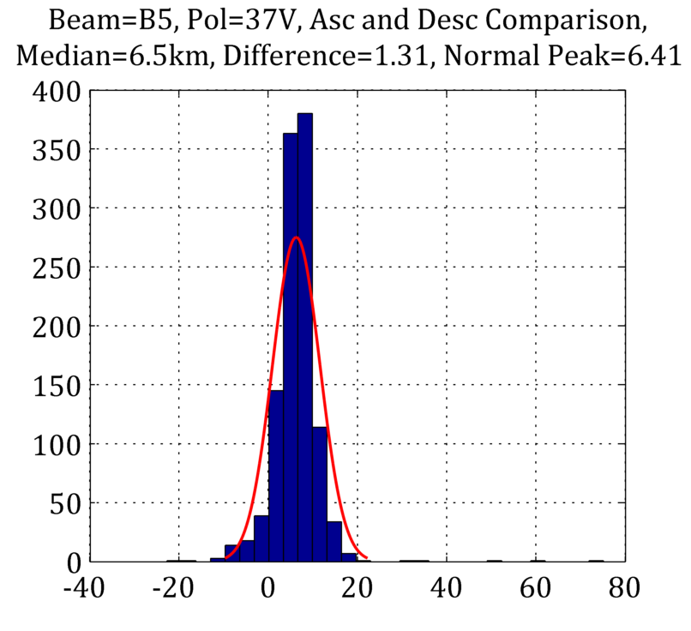
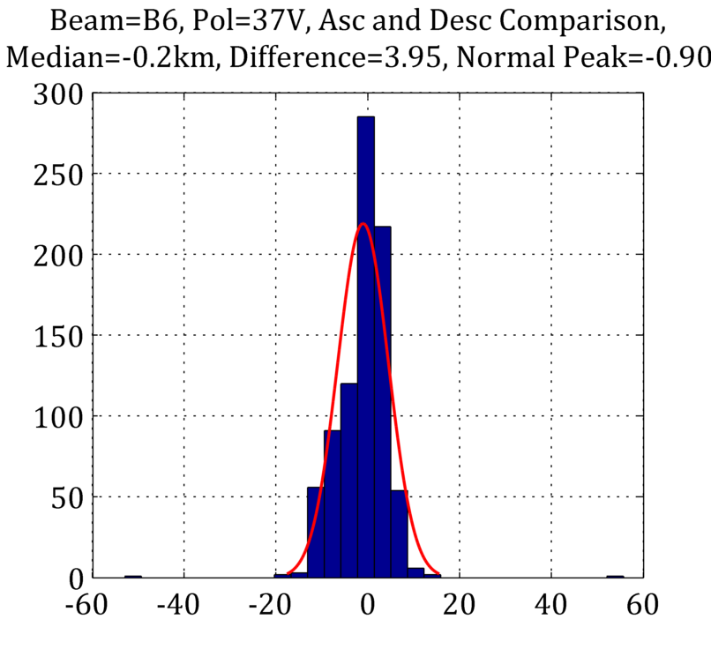
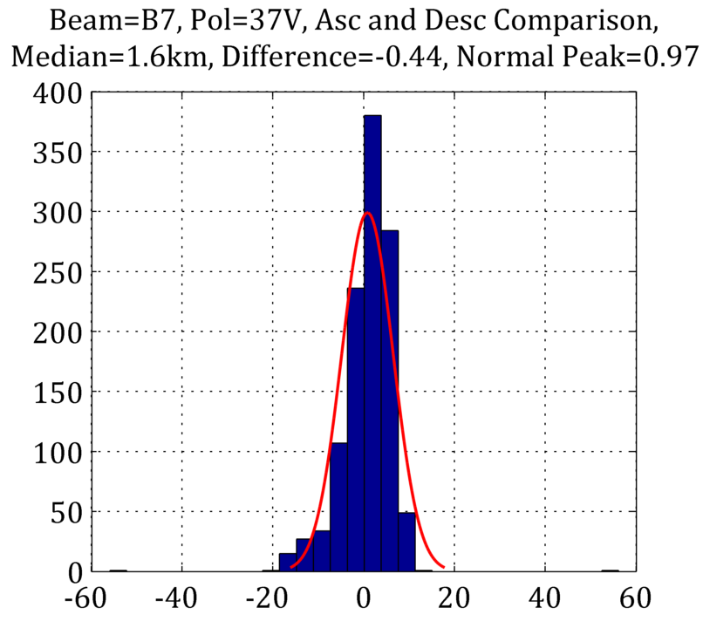
Geolocation Histograms for 8 beams 37V

Slide 29
Results Table
 | Beam 1 |  |  |  | Beam 2 |  |  |  | Beam 3 |  |  |  | Beam 4
 | Median Error | Error Std. Dev | N |  | Median Error | Error Std. Dev | N |  | Median Error | Error Std. Dev | N |  | Median Error | Error Std. Dev | N
36.5V | M=1.9 | σ=4.3 | n=699 |  | M=6.8 | σ=2.0 | n=483 |  | M=4.2 | σ=3.7 | n=1100 |  | M=2.4 | σ=1.9 | n=722
36.5H | M=4.7 | σ=4.5 | n=1193 |  | M=5.3 | σ=5.4 | n=802 |  | M=3.0 | σ=2.4 | n=1020 |  | M=3.2 | σ=4.1 | n=989
23.8H | M=1.6 | σ=3.7 | n=511 |  | M=-0.2 | σ=5.5 | n=441 |  | M=-1.1 | σ=3.5 | n=700 |  | M=-0.9 | σ=2.2 | n=536
*All errors in units of kilometers
 | Beam 5 |  |  |  | Beam 6 |  |  |  | Beam 7 |  |  |  | Beam 8
 | Median Error | Error Std. Dev | N |  | Median Error | Error Std. Dev | N |  | Median Error | Error Std. Dev | N |  | Median Error | Error Std. Dev | N
36.5V | M=1.2 | σ=2.4 | n=790 |  | M=2.7 | σ=2.0 | n=745 |  | M=5.2 | σ=3.9 | n=920 |  | M=3.8 | σ=4.1 | n=486
36.5H | M=2.7 | σ=3.2 | n=1076 |  | M=1.9 | σ=4.2 | n=1196 |  | M=4.6 | σ=4.6 | n=1032 |  | M=4.8 | σ=2.4 | n=763
23.8H | M=1.6 | σ=5.6 | n=712 |  | M=-.3 | σ=6.3 | n=561 |  | M=1.0 | σ=1.9 | n=316 |  | M=.8 | σ=3.9 | n=522

Slide 30
Conclusions: All thesis objectives met!
Objective: Create algorithm to calculate MWR geolocation error
Implemented max-slope algorithm and verified 50% beam-fill using 2D MWR antenna pattern convolutions against real Tb images of land/water coast
Objective: Develop software package to analyze MWR orbit data
22,000 lines of code
Refined processing time from four days to three hours to process one-year data
Objective: Process at least one-year of data (full seasonal cycle) to generate statistics
3-year data record will be processed by thesis completion
Objective: Generate statistical database of mispointing errors for CONAE use
Preliminary processing complete for one-year, additional analysis to be completed by thesis completion

Slide 31
Future Work
Analysis of collocation histograms to determine systematic effects
Ascending & descending orbital passes
Orientation of IFOV elliptical axis relative to coastline
Apparent pointing error for 37H & 37V beams
Conversion of geolocation error (km) to antenna pointing angles: azimuth and elevation
Validation of beam pointing results using Deep space calibration (transitions between earth limb & space)
Notes:
Error analysis of uncertainty, **add to paper**, one example from each set of beams

Slide 32
Publications
Conference
[1] B. Clymer, C. May, L. Schneider, F. Madero, M. LaBanda, M. Jacob and W. Jones, 'Microwave Radiometer (MWR) Beam-Pointing Validation for the Aquarius/SAC-D Mission', in MicroRad, United States, 2014.
[2] B. Clymer, 'MicroWave Radiometer Beam-Pointing Validation for the Aquarius/SAC-D Mission', in Aquarius Science Team Meeting, Seattle, WA, 2015.
Journal
B. Clymer, F. Madero, M. Jacob, W. Jones and C. May, 'Microwave Radiometer (MWR) Evaluation Of Multi-beam Satellite Antenna Boresight Pointing Using Land/Water Crossings For The Aquarius/SAC-D Mission', JSTARS - Journal of Selected Topics in Applied Earth Observations and Remote Sensing, vol. 8. Under Review
Notes:
Shoot for 30

Slide 33
END

Slide 34
Back-Up Slides
Backup
Notes:
Some of Nick’s charts

Slide 35
References
Omit or put into back-up
[1]B. Tieu and M. Suarez, "Mission Plan, Tech. Report AS-213-0097, 2009," Buenos Aires, Argentina, 2009.
[2]Gallery. (n.d.). Retrieved March 17, 2015, from http://aquarius.umaine.edu/cgi/gallery.htm
[3]Aquarius/SAC-D Project Overview. (2011, June 1). Retrieved March 12, 2015, from http://aquarius.nasa.gov/pdfs/mission_summary.pdf
[4]Heliosynchronous Orbit Graphic - "Heliosynchronous orbit" by Heliosynchronous_Orbit.png: BrandirXZise - This file was derived from: Heliosynchronous Orbit.png:. Licensed under CC BY-SA 3.0 via Wikimedia Commons - http://commons.wikimedia.org/wiki/File:Heliosynchronous_orbit.svg#/media/File:Heliosynchronous_orbit.svg
[5] May, C. (2012). Engineering evaluation of multi-beam satellite antenna boresight pointing using land/water crossings. Orlando, Fla.: University of Central Florida.

Slide 36
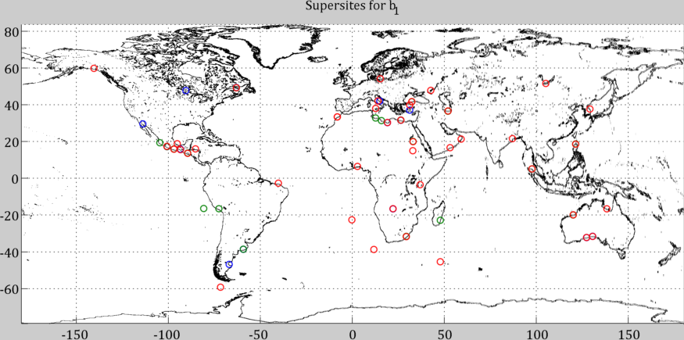

Slide 37
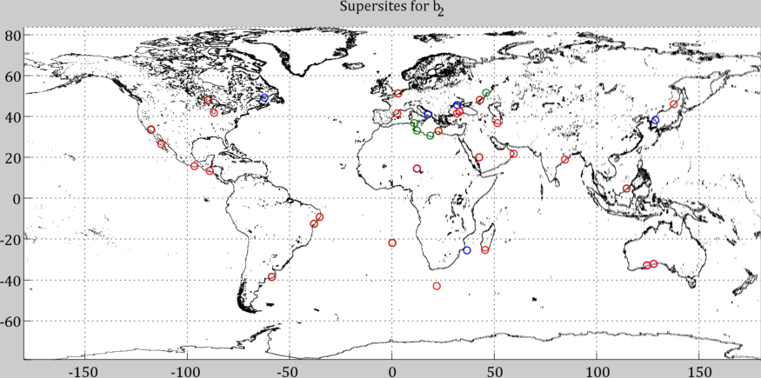

Slide 38
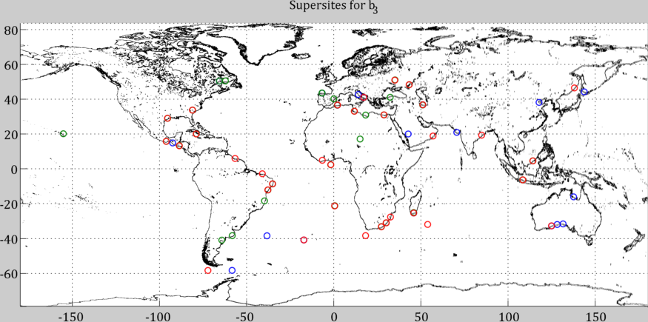

Slide 39
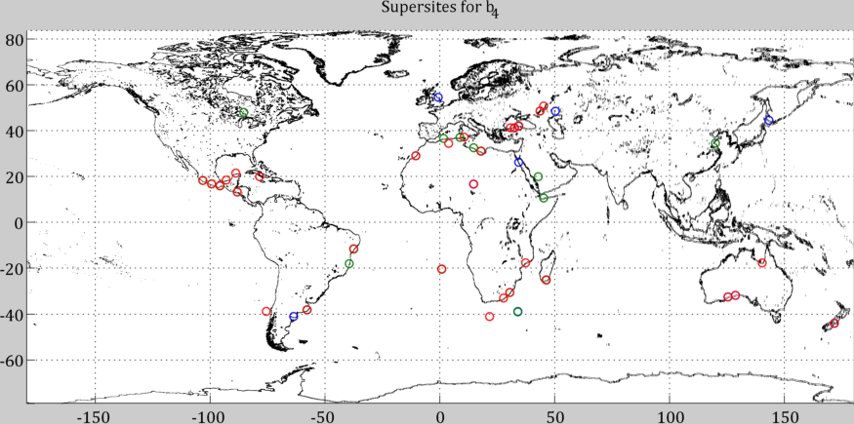

Slide 40
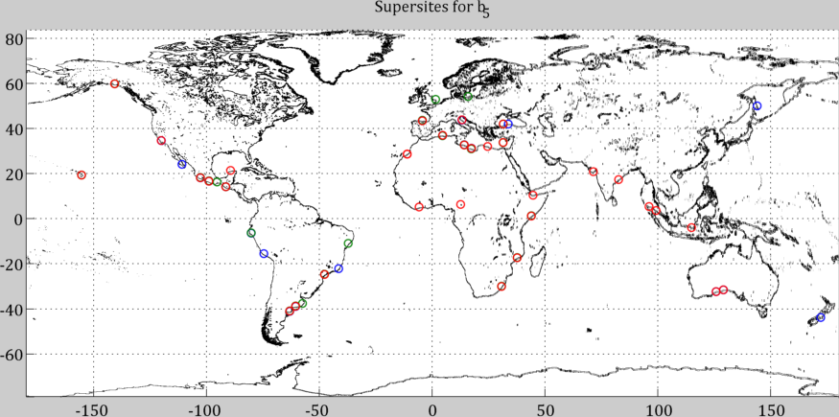

Slide 41
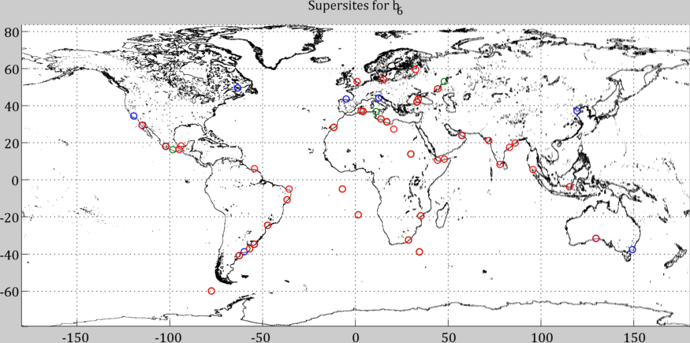

Slide 42
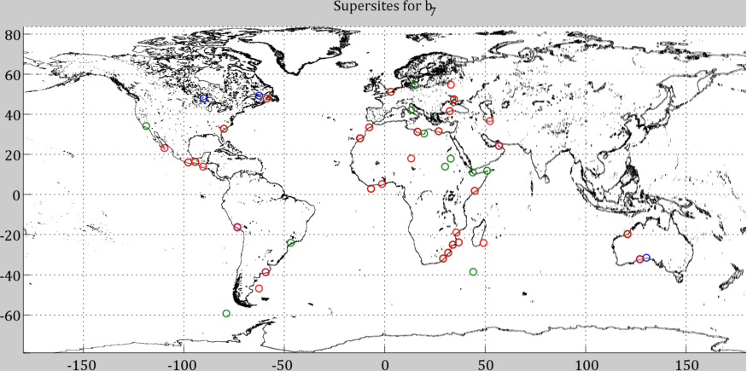

Slide 43
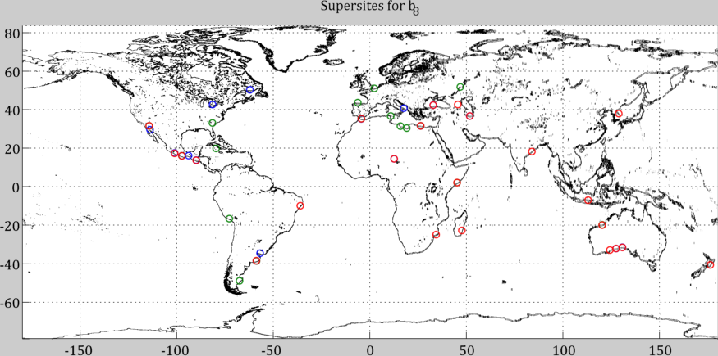

Slide 44
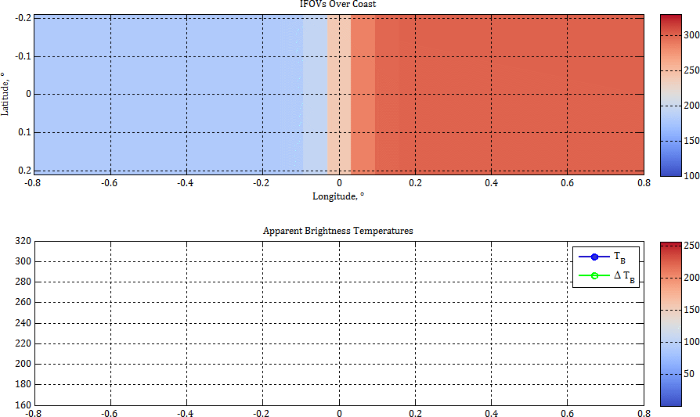
Brightness Temperatures Over a Coast
Water on left, land on right
Beam efficiency picks up incremental increase in radiated power
Gaussian ellipse approximation to more complex beam pattern
Notes:
Animation of Ellipses

Slide 45
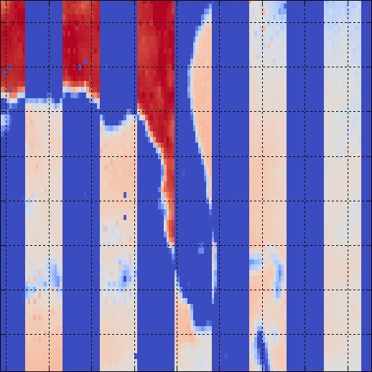
SuperSite Finding Algorithm: Step 1
I guess that you want to show how you automated the process. OK, this is good, but it’s not the most important thing that you did! Devoting more than 1 or 2 slides is too many.
Classify each orbit by ascending node
Aggregate orbits into matrices
Take column-wise mean of each matrix
Difference each of 103 time series to find slope
Evaluate sites above desired threshold heuristically
Align matrices by ascending node
Notes:
Backup charts, down to one or two

Slide 46
SuperSite Finding Algorithm: Step 2
Classify each orbit by ascending node
Aggregate orbits into matrices
Take column-wise mean of each matrix
Difference each of 103 time series to find slope
Evaluate sites above desired threshold heuristically
Align matrices by ascending node

Slide 47
SuperSite Finding Algorithm: Step 3
Classify each orbit by ascending node
Aggregate orbits into matrices
Take column-wise mean of each matrix
Difference each of 103 time series to find slope
Evaluate sites above desired threshold heuristically
Align matrices by ascending node

Slide 48
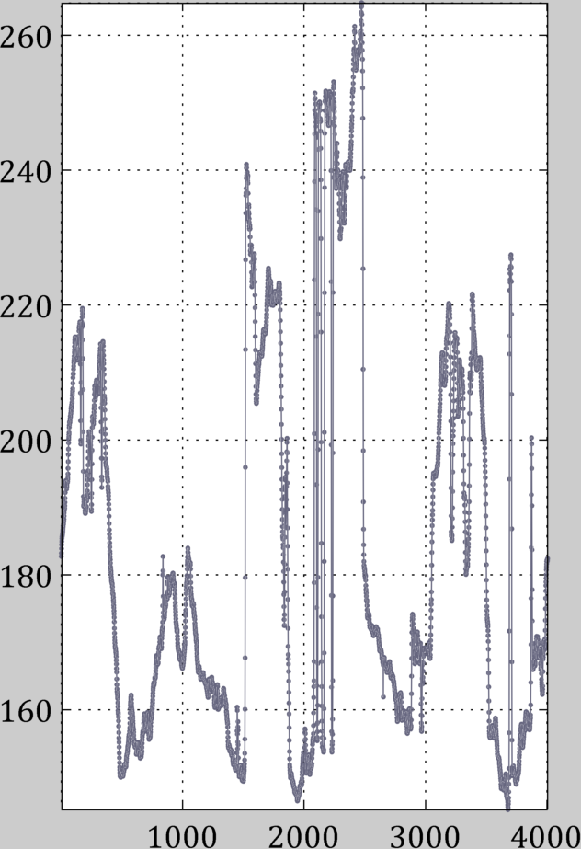
SuperSite Finding Algorithm: Step 4
Classify each orbit by ascending node
Aggregate orbits into matrices
Take column-wise mean of each matrix
Difference each of 103 time series to find slope
Evaluate sites above desired threshold heuristically
Align matrices by ascending node

Slide 49
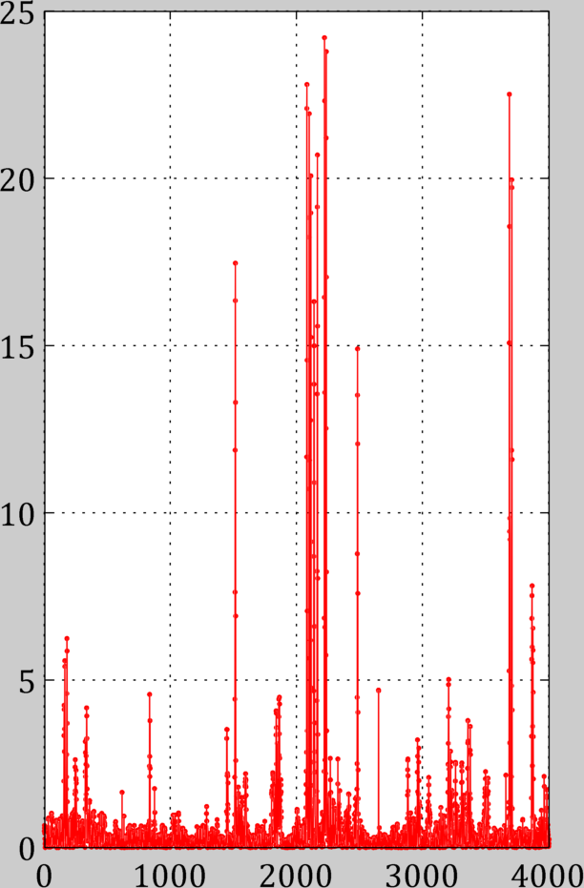
SuperSite Finding Algorithm: Step 5
Classify each orbit by ascending node
Aggregate orbits into matrices
Take column-wise mean of each matrix
Difference each of 103 time series to find slope
Evaluate sites above desired threshold heuristically
Align matrices by ascending node

Slide 50
SuperSite Finding Algorithm: Step 5
Classify each orbit by ascending node
Aggregate orbits into matrices
Take column-wise mean of each matrix
Difference each of 103 time series to find slope
Evaluate sites above desired threshold heuristically
Align matrices by ascending node
Threshold

Slide 51
Lines of Code

Slide 52
37V Antenna Pattern

Slide 53
Thesis Organization
Research Obj – OK as revised - Done
Intro – combine 5 & 6 into one slide – the science in NOT important - Done
AQ/MWR geometry – slides 7, 8, 9 are OK as revised
Related Past work –
not good! Make a slide/past work and give detail of how they did it (NOT #”s results). If possible make one slide and not two.
Present Cathy’s thesis summary of what she did. Her work was more of a “proof of concept” for MWR and preliminary #’s for geoloc errors
What you did! - Present a bullet slide of what you did to extend this research beyond Cathy May
Technique description
slide -12 is Cathy’s hypothesis based ion 1D convolution of a Gaussian ant beam with a step function land/water boundary
Insert a slide on the 2D ant pattern convolution that you performed to demonstrate the the max slope point is the 50% land/50% water for the IFOV (insensitive the the alignment of the ellipse relative to the coast line.
Slide-13 is OK but there are some issues listed on the slide (make this the lowest priority to fix).
Algorithm description
Slides 14 – 18 are OK with comments considered, but slide – 19 misses the mark (see comments)
Slides 20 – 29 are not good and put too much emphasis on a minor point – see my comments to reduce to 2-3 slides.
Results
Slides 30 – 32 are OK but you need to add more results – see my notes on 32. This should be 5 – 8 slides
Conclusions – will come after reviewing your presentation – Monday afternoon or early evening.

